Slide 1
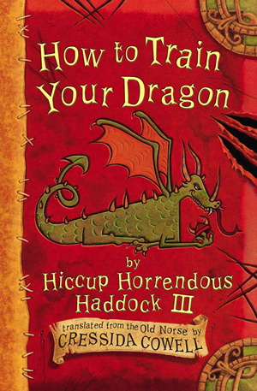
Chapter 15
The Battle at Death’s Head Headland
and
Chapter 16 The Fiendishly Clever Plan Goes Wrong

Slide 2
15.The battle at death’s head headland
1. Why do animals of the same breed not normally attack each other?
2. Why did the boys start laughing hysterically?
3. What is another word for ‘desert’?

Slide 3
16. The fiendishly clever plan goes wrong
1. What did the Green Death intend to use to kill the boys when they hid themselves in the bracken?
2. What simile does the author use to compare the dragon’s mouth to?

Slide 4
Hiccup needs your help
Oh No, Hiccup’s Fiendishly Clever plan to defeat two Seadragonus Giganticus Maximus looks like it has gone wrong. Now Hiccup needs your help to think of a better plan to get rid of the Sea Dragons.

