Slide 1
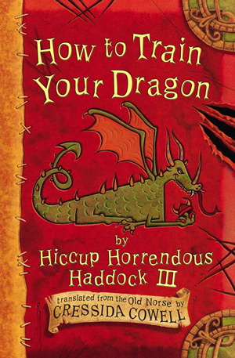
Chapter 13
When Yelling Doesn’t Work

Slide 2
13. When yelling doesn’t work
What did Stoick never do?
2. What does Thuggory call Snotlout?
3. Who does Hiccup warm to and why?
4. What did Hiccup call the second dragon?
5. What was Hiccup’s fiendishly clever plan?
6. Where were the twenty dragons?
7. What did the dragons decide to do?

Slide 3
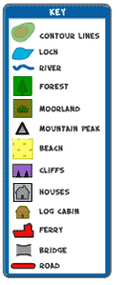
Create a map with a key
The Isle of Berk and Meathead Island are packed with information including place names, villages, beaches and geographical features.
When drawing the map it will be hard to write everything on the map. A way to fit everything on the map is to create a key.
On the map draw symbols to represent villages, graveyards and high points, use initials instead of the names.
On the side of the map copy the symbols and initials you have used and write out the name or feature in full. (MV = Meathead Village)
You can also use different colours on the key.

